Slide 1
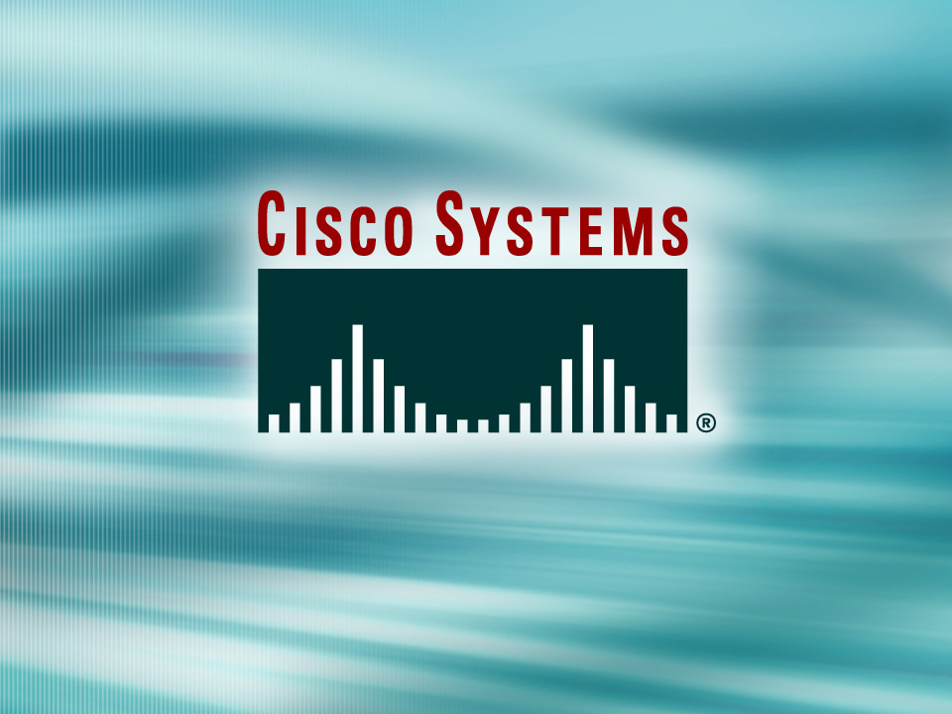
Presentation_ID
© 2002, Cisco Systems, Inc. All rights reserved.

Slide 2
CLI Switching
Torrey Y. Suzuki
tosuzuki@cisco.com
Cisco Systems, Inc.

Slide 3
Outline
CLI Switching
Inter-VLAN Routing

Slide 4
Overview
Two general categories of switches:
  Access layer switches (1900, 29xx)
    Have CLIs (command line interface) similar to Cisco routers. (IOS based).
  Distribution layer switches (Catalyst 4000, 5000, 6000)
    Set command based.
This presentation describes the CLI used in access layer switches

Slide 5
Catalyst IOS Intro
User EXEC mode and Privileged EXEC mode.
  enable command.
IOS based switch is just like the router IOS.
  configure command – go to global config mode.
  copy run start – to save config to NVRAM.
Host Name configuration -1-255 characters
  hostname [name]
Comment to help identify the interface.
  description [description-string] - interface config. mode
  Use quotes when using spaces in string.
IOS-based: same as on a router.
  access help by entering ?

Slide 6
Remote Access to Switch
To telnet, ping, or globally manage the switch:
  need an IP address and management VLAN.
IOS-based
  interface vlan 1
  ip address [address][mask]
  ip default-gateway [address]
  Verify with show ip interface
Notes:
Recall - traffic flows up the hierarchical model just high enough to reach final destination.
Access layer routers would have more processing power available to implement network policies.

Slide 7
Defining port speed / duplex
IOS-based:
  On interface: speed [10 | 100 | auto]
Line mode is either full duplex or half duplex.
IOS based switch, on interface:
  duplex [auto | full | half]
  auto option only for fixed Fast Ethernet TX ports.
Notes:
Recall - traffic flows up the hierarchical model just high enough to reach final destination.
Access layer routers would have more processing power available to implement network policies.

Slide 8
Backup on TFTP Server
IOS-based commands:
  copy run tftp – to save config file to tftp server.
  copy tftp run – to download config from tftp server to active config and to NVRAM.

Slide 9
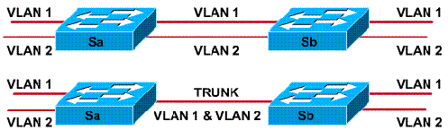
Trunking Overview
Trunk: point-to-point link, supports several VLANs.
  purpose is to save ports.
Frame is ‘tagged’ to indicate which VLAN it belongs to for transport over trunk.
  Different tagging schemes:
    ISL Cisco proprietary InterSwitch Link protocol.
    IEEE 802.1Q

Slide 10
Outline
CLI Switching
Inter-VLAN Routing

Slide 11
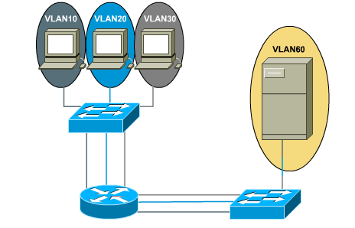
Multiple links aren’t scalable
Requires three ports for three VLANs; this router is getting expen$ive!

Slide 12
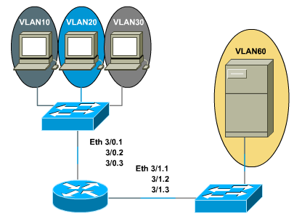
Trunking Provides Scalability
Subinterfaces are only on the router.
Using ISL or 801.Q, router only needs one port.
Note: this must be FastEthernet!

Slide 13
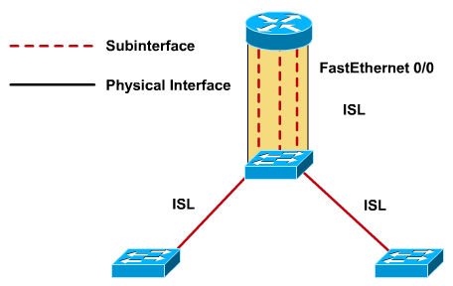
External router config example
“Router on a Stick”

Slide 14
External router config example
RTA(config)#interface f0/0
RTA(config-if)#no ip address
RTA(config-if)#interface f0/0.1
RTA(config-subif)#encapsulation isl 1
RTA(config-subif)#ip address 10.1.1.1
RTA(config-subif)#in f0/0.2
RTA(config-subif)#encapsulation isl 2
RTA(config-subif)#ip address 10.1.2.1
RTA(config-subif)#in f0/0.3
RTA(config-subif)#encapsulation isl 3
RTA(config-subif)#ip address 10.1.3.1
Creates sub interface (good idea to use VLAN number-but not required)
Sets trunk encapsulation and specifies VLAN
Specifies IP for this interface; will be default gateway for VLAN 1 hosts.

Slide 15
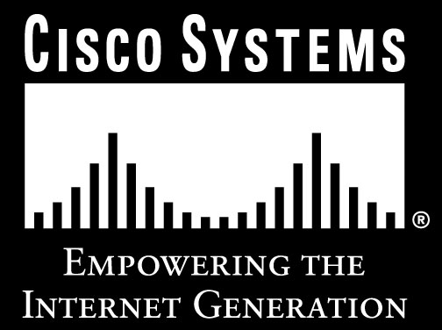
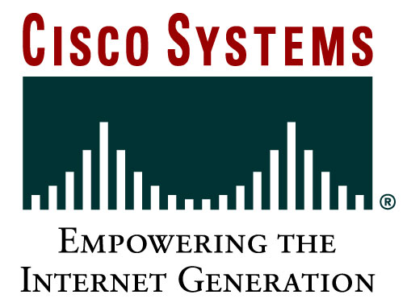
Presentation_ID
© 2002, Cisco Systems, Inc. All rights reserved.

